Slide 1
Sui, Tang, and Song

Slide 2
Sui (589 – 618)
After Han: Era of Six Dynasties
Sui reunified (under Yang Jian)
Buddhism
Grand Canal
Militaristic and violent
Murdered
Li Yuan took over
Founded Tang (618-907)

Slide 3
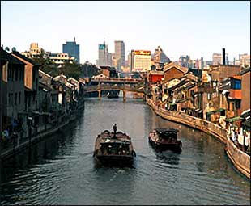
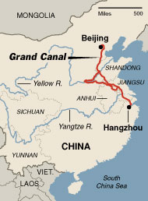

Slide 4
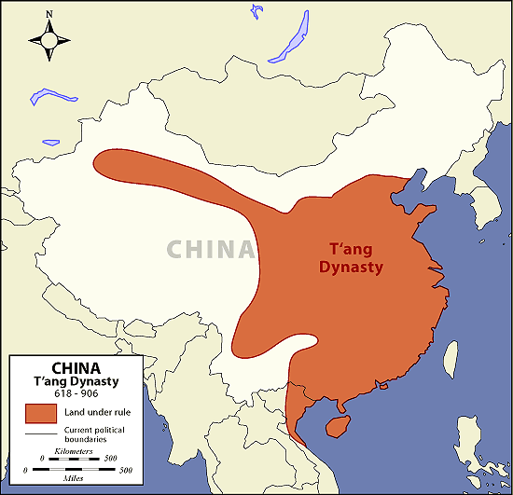
Tang
Capital (Chang’an)
Pop. 2 million
Paper Money

Slide 5
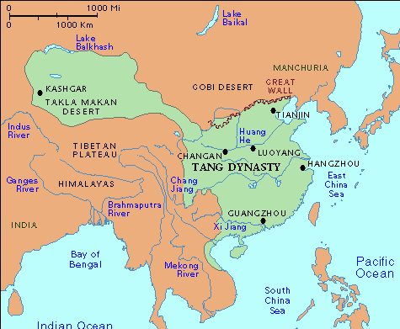

Slide 6
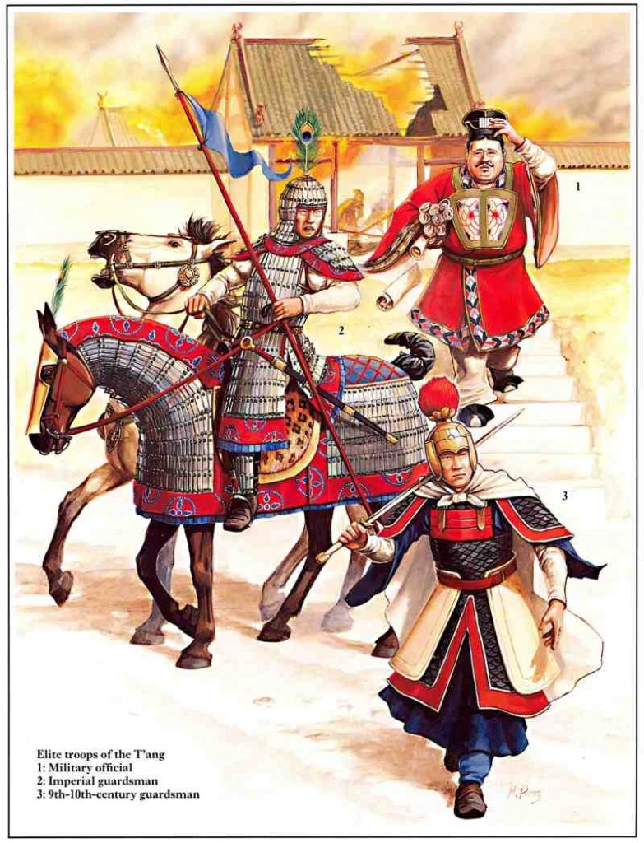
Tang Policies
Bureaucracy of merit
Harder Confucian-emphasized exams
Equal Field System
Major Expansion
Tributary System

Slide 7
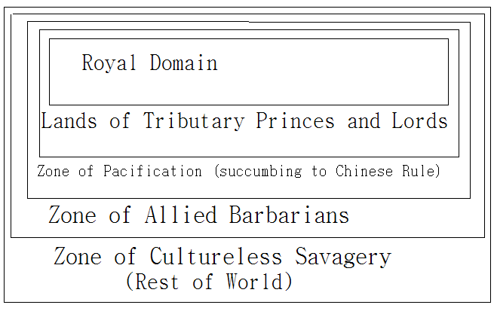

Slide 8
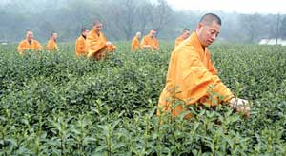
Buddhism
Zen (Chan)
Pureland
845 – Persecution

Slide 9
An Lushan Rebellion
755-763
Defeated by Uighurs
Generals who retook a province became governor
Tang never recover

Slide 10
Chaos (era of five dynasties) 907-960

Slide 11
Song
960 – 1279
Civil Service exams
Professionals in bureaucracy
Equal opportunity?

Slide 12
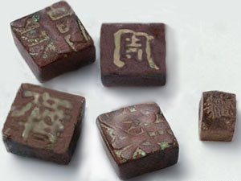
Society
Moveable type printing
Cheaper books
Compass
Gunpowder

Slide 13
Economy
Land reform
Fast growing rice
Urbanization
Introduction of steel, cotton, gunpowder

Slide 14
Society
Footbinding
Banned 1949

Slide 15
Religion
Neo-Confucianism
Zhu Xi
Revival of Confucianism
Secular (rejected Buddhism)
World is real: fulfillment comes from participation, not withdrawal
Adopted metaphysical principals of Buddhism and Daoism

Slide 16
Decline and Fall of Song
Army expensive
Jurchen 1126
Song Reestablished
Southern Song (capital Huangzhou)
Fell to Mongols 1279

Slide 17
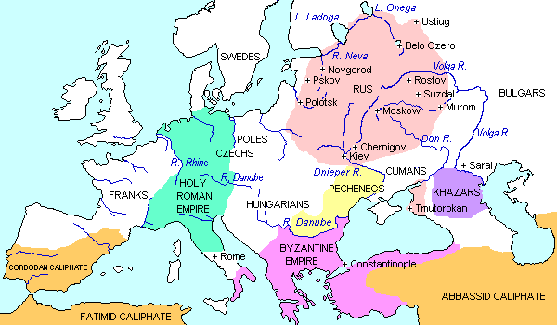
Russia (Pre Mongol)
Blend of Scandinavians and Slavs
City: Kiev

Slide 18
Religion
987
Vladimir needs to choose a religion
Sends emissaries to study
1.) Eastern Orthodox
2.) Islam
3.) Roman Catholicism
What are the advantages and disadvantages?
(Think about the fact that you are studying this for a king)

Slide 19
“The Greeks led us to the buildings where they worship their God, and we knew not whether we were in heaven or on earth. For on earth there is no such splendor or such beauty, and we are at a loss how to describe it. We only know that God dwells there among men and we cannot forget that beauty.”

Slide 20
Eastern Orthodox
Cyrillic Alphabet

